Slide 1
A student’s first session in Recall
1
Create an account
Select “Create an account”, enter your name, email and password, then choose “Create account”.
2
Choose a topic
Open Practice and select Memory to start a three-question session.
3
Answer and review
Answer from memory, rate your confidence and select “Check my answer”. Tick the points you covered, then save your review.
4
Open your portfolio
After the third review, select “Finish & view portfolio”. Compare your results to see what to practise next.
The next slide shows a student’s answers from one Memory session.
Notes:
Show the sign-up screen. Use a demo account to keep the presentation moving. From the dashboard, select Practice and then Memory. Each question asks for an answer and a confidence rating. On the feedback screen, tick only the points the answer covers. Choose Save review & continue after each of the first two questions. On the third, choose Finish & view portfolio. The portfolio records the latest answer-point coverage for each question. You can revisit it later under My portfolio.

Slide 2
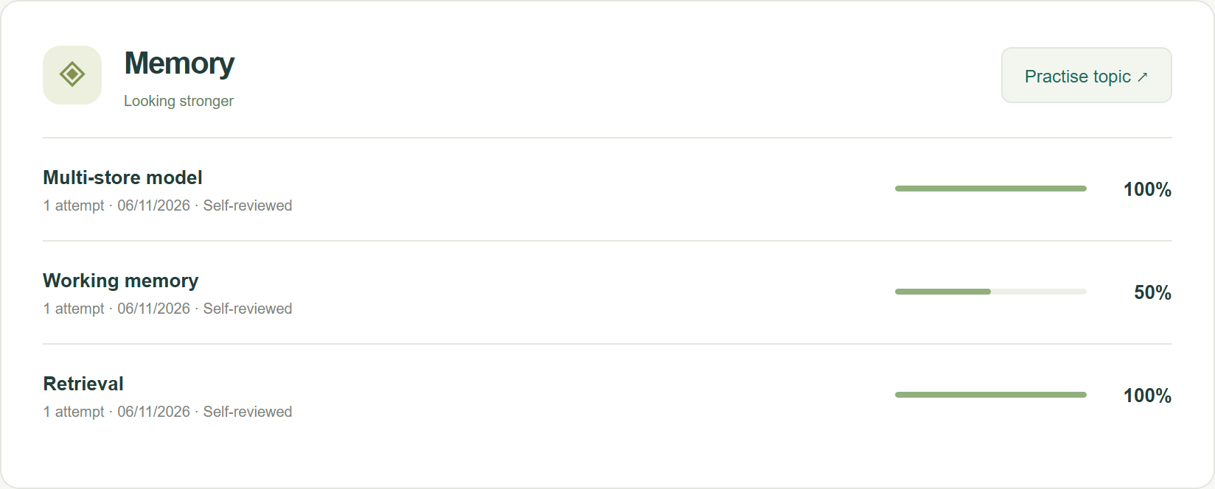
Recall’s A-level Psychology revision demo
Memory practice
Student portfolio after three questions
“Explain the role of the central executive in working memory.”
The student answers, “It directs attention.”
Recall flags one of two answer points by keyword. The student confirms that their answer covered attention.
Next time, explain how the central executive coordinates the other components.
Live prototype
<URL>
Notes:
Before presenting, replace <URL> with your prototype link. Sign in to a demo student account and open Practice → Memory. For a short live demo, complete the first question beforehand and pause on the second.
Ask the audience what is missing from “It directs attention.” Enter the answer, select a confidence level and click Check my answer. Show the two answer points. Attention is covered. Coordinating the other components and allocating resources is the missing point. Confirm the checkboxes and click Save review & continue.
Finish the retrieval question and open the portfolio. The 50% shown here means the student covered one of the two points in their latest working-memory answer. A teacher can inspect the saved answer in the admin dashboard and ask the student to explain how the central executive coordinates the phonological loop and visuospatial sketchpad.
This demonstration uses a sample student session. The prototype uses keyword checks and student self-review. No AI service is connected.

